Slide 1
Sequential circuits
Summary
Sequential circuits is composed by the combinational logical circuit and the save circuit. Sequential circuits can be divided into the synchronous circuits and asynchronous circuits, according to their triggered methods。

Slide 2
1．The characteristics of sequential logical circuit
(1) memory unit (flip-flops used usually)
(2)feedback parts
input
X
1
Z
1
output
…
Combinational
circuit
…
signal
X
i
Z
j
signal
Q
D
1
1
Flip-flop
Flip-flop
circuit
Flip-flop
…
…
Output signal
Input signal
Q
D
m
m
CP

Slide 3
时序逻辑电路的分类
按照存储电路中触发器状态变化的特点：
同步时序电路：所有触发器都受同一时钟信号控制，触发器的状态是同步变化的；
异步时序电路：并非所有触发器都受同一时钟信号控制，因此触发器的状态不是同步变化的。
按照电路输出信号的特点：
Mealy型电路：输出不仅取决于电路的状态，还与电路的输入有关；
Moore型电路：输出仅仅取决于电路的状态，与电路的输入无关。
按照触发方式的不同：
电平触发：当触发信号为有效电平时，输入信号直接影响触发器状态。
脉冲触发：时钟脉冲有效期间，输入信号影响触发器状态。
边沿触发：高、低电平的转换过程引起触发器状态的改变。

Slide 4
The analysis method of sequential circuit
Ⅰ.The universal steps of analysising sequential circuit
1.Wirte out the following equations according to logical map
(1)The clock equation of flip-flops
(2)The output equation of sequential circuit
(3)The drive equation of flip-flops
2.Subtitute the drive equation into the characteristic equation of the correspondence flip-flops and get the state equation of sequential circuit.
3.According to the state equation and output equation, write the state table of the sequential circuit and picture the state map and sequential map
4.Explain the given sequential circuit’s function, according to the state table or state map.

Slide 5
Ⅱ. The example of the analysis of the synchronous sequential logical circuit
Example: Analyse the following sequential logical circuit
Solution: it is the synchronous sequential logical circuit, its clock equation isn’t needed to write out.

Slide 6
(1) Write out its output equation:
(2) Write out its drive equation:
(3) Write out JK’S characteristic equation, and substitute all drive equations into it, and get the next state equation of all flip-flops

Slide 7
（4）Write out the state conversion table and state map
① When X=0, we can simplify the flip-flops’ next state equation as
Simplify the output as

Slide 8
When X=0, the state table is
Present state
Next state
output
Q₁^{n} Q₀^{n}
Q₁^{n+1} Q₀^{n+1}
Z
0 0
0 1
1 0
0 1
1 0
0 0
0
0
1
When X=0, the state map is

Slide 9
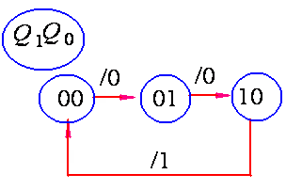
The next state equations of all flip-flops

Slide 10
②When X=1, we can simplify the flip-flops’ next state equation as
Simplify the output equation as
When X=1, the state table is
Present state
Next state
output
Q₁^{n} Q₀^{n}
Q₁^{n+1} Q₀^{n+1}
Z
0 0
1 0
0 1
1 0
0 1
0 0
1
0
0

Slide 11
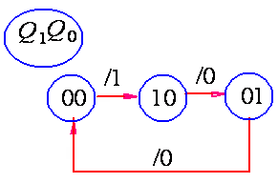
When X=0, the state map is
We can get the complete state map after the two above conditions are combinated

Slide 12
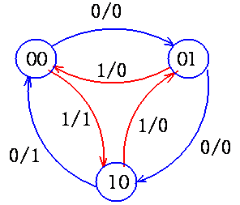

Slide 13
（5）Picture sequential map
According to the state map or state table, we can get the sequential map of the circuit which is influenced by the CP impulse

Slide 14
（6）Analysis its logical function
The circuit has three states 00、01、10.
When X=0, it changes circularly from 00→01→10→00; when its state is 10 (the max), Z is 1;
When X=1, it changes circularly from10→01→00→10; when its state is 00 (the min), Z is 1.
So this circuit is a controllable three carry system counter.
The complete state map

Slide 16
Ⅲ. The example of the analysis of the asynchronous sequential logical circuit
Example: Analyse the following sequential circuit

Slide 17
（1）Write out all logical equations
① Clock equation
CP₀=CP （increase edge triggered。）
CP₁=Q₀ （When the Q₀ of FF₀ is 0→1，Q₁ can change its state）
Clock equation is CP₀=CP CP₁=Q₀
② Output equation
③ The drive equations of all flip-flops
（2）We can get the next state equation of all flip-flops when the drive equation is substituted into D flip-flops characteristic equation

Slide 18
（CP 0→1 effectively）
（CP 0→1 effectively）
（3）Write out the state conversion table
CP₁ CP₀
Present state
Next state
output
Clock impulse
Q₁^{n} Q₀^{n}
Q₁^{n+1} Q₀^{n+1}
Z
CP₁ CP₀
0 0
1 1
1 0
0 1
1 1
1 0
0 1
0 0
1
0
0
0
0
0

Slide 19
（4）Picture the state conversion map and sequential map

Slide 20
（5）Analysis its logical function
This circuit has four states 00、01、10、11, it changes circularly degressively under the influence of CP, so it is a four carry system descend counter, Z is the borrow signal

Slide 21
Ⅱ. The counter
The kinds of counter:
①binary counter ,nonbinary counter. The decimal counter is one normal kind of the nonbinary counter.
②there are add counter, descend counter and reversible counter, according to the trend of number.
③synchronous and asynchronous
1. binary counter
(1) binary counter
① binary asynchronous counter
a. binary asynchronous add counter

Slide 22
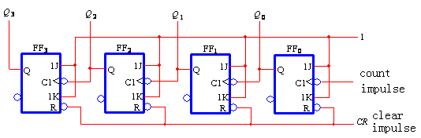
Work principle: the four JK flip-flops are connected inorder to compose the counter
When a descending dege of CP is coming, FF0 turns over once;
When Q0 is 1 0，FF1 turns over once；
When Q1 is 1 0，FF2 turns over once；
When Q3 is 1 0，FF3 turns over once；

Slide 23
With the “observation method” , we can write out the sequential wave map and state map of the circuit

Slide 24
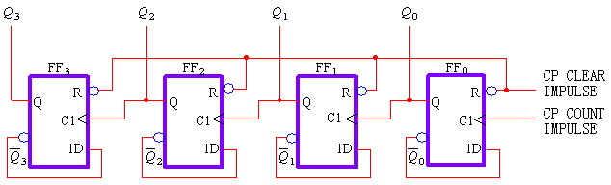
From the sequential map we can see that the cycle of the Q0、Ql、Q2、Q3 is the 2 times、4times、 8times 、 16 times of the cycle of the counte impulse respectively, therefore, the counter can be looked as frequency divider.
b. binary asynchronous descending counter
The binary descending counter is composed by four increasing edged triggered flip-flops

Slide 25
Work principle: The D flip-flop is connected as flip-flop
The Q end of the low level flip-flop is connected to the clock impulse input end of the high flip-flop, that the borrow signal is taken from Q end.. It also has the frequency divider function The sequential wave map and state map of the binary asynchronous descending counter

Slide 26
②binary synchronous counter
a.binary synchronous add counter
Use the “observation method” to design circuit; the cp ends of all flip-flops are connected to the one count impulse; analysis the state map and select the suitable JK signals

Slide 27
The counte impulse signals | The circuit sate | The decimal number (effectively)
 | Q3 Q2 Q1 Q0
0 1 2 3 4 5 6 7 8 9 10 11 12 13 14 15 16 | 0 0 0 0 0 0 0 1 0 0 1 0 0 0 1 1 0 1 0 0 0 1 0 1 0 1 1 0 0 1 1 1 1 0 0 0 1 0 0 1 1 0 1 0 1 0 1 1 1 1 0 0 1 1 0 1 1 1 1 0 1 1 1 1 0 0 0 0 | 0 1 2 3 4 5 6 7 8 9 10 11 12 13 14 15 0

Slide 28
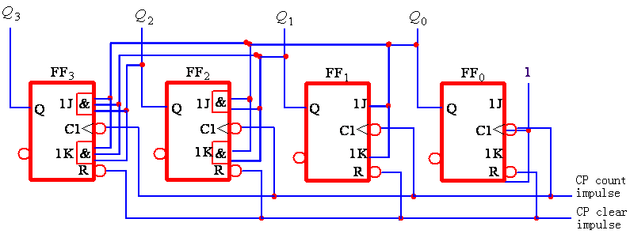
Analysis the state map:
FF0：Whe cp comes once, it toggles once; so select:J0=K0=1
FF1：When Q0=1 and CP comes once，it toggles contrarily once, so select: J1=K1= Q0
FF2：When Q0Q1=1 and CP comes once，it toggles contrarily once，so select: J2=K2= Q0Q1
FF3： When Q0Q1Q2=1 and CP comes once，it toggles contrarily once，so select:， J3=K3= Q0Q1Q2

Slide 29
b. binary synchronous descending counter
From the state map of the binary synchronous add counter, we can get the binary synchronous descending counter by changing the drive equation as follows:
c. binary reversible counter
Inorder to get the four bits synchronous counter, we can combinate the adding counter and the descending counter and introduce a adding/descending control signal X, the drive equations are :

Slide 30
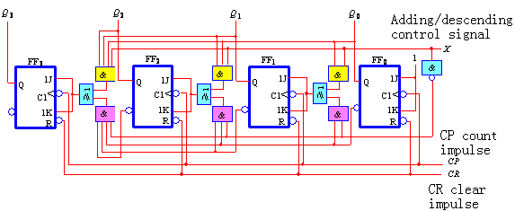
Its logical map
When the control signal X=1, the J、K ends of FF1～FF3 is connected to the Q end of the low level flip-flops, and carry adding operation;
When the control signal X=0, the J、K ends of FF1～FF3 is connected to the end of the low level flip-flops, and carry descending operation.

Slide 31
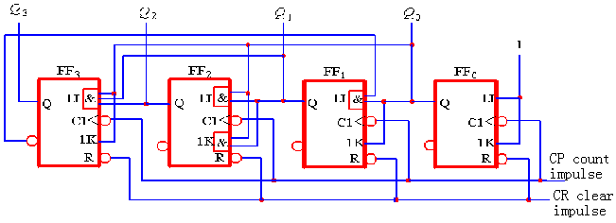
2. nonbinary counter
N=2^{n} ,it module is N, N bits binary counter
N≠2^{n}，nonbinary counter. The most usual is decimal carry system counter。
① 8421BCD code synchronous decimal adding counter

Slide 32
Analysis the circuit with the method which has been introduced to analysis the synchronous circuit:
a. drive equation
b.convert it to the next equation
the characteristic equation of JK flip-flops
substitute all the drive equation into the characteristic equation of JK flip-flops and get the next state equation of all flip-flops

Slide 33
c. state conversion table
Suppose the beginning state is Q3Q2Q1Q0=0000, substitute it into the next equation and get the state conversion table

Slide 34
Present state | Next state
Q₃^{n} Q₂^{n} Q₁^{n} Q₀^{n} | Q₃^{n+1} Q₂^{n+1} Q₁^{n+1} Q₀^{n+1}
0 0 0 0 0 0 0 1 0 0 1 0 0 0 1 1 0 1 0 0 0 1 0 1 0 1 1 0 0 1 1 1 1 0 0 0 1 0 0 1 | 0 0 0 1 0 0 1 0 0 0 1 1 0 1 0 0 0 1 0 1 0 1 1 0 0 1 1 1 1 0 0 0 1 0 0 1 0 0 0 0

Slide 35
d state map and sequential map

Slide 36
e. Test circuit whether self-starting
There are four flip-flops in the circuit, so it has 16 kinds combination. Ten kinds are used in 8421BCD code counter, they are called the effective state, the other six are called invalid state
Owing some reasons, the flip-flop becomes the valid state. If it can become effective state under the CP influence, it is called self –starting
Solution the next state of the six invalid states to get the whole state conversion map

Slide 37
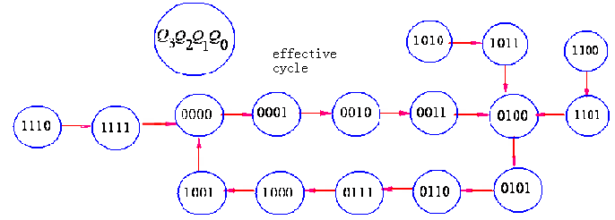
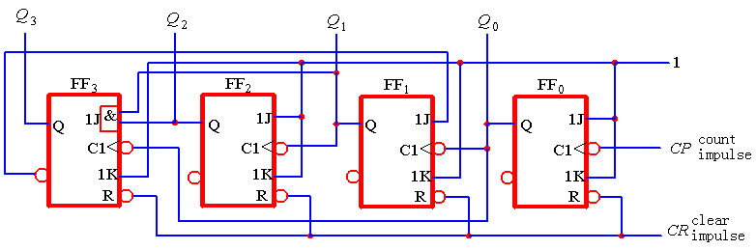
It is self-starting.
②8421 asychronous decimal adding counter

Slide 38
Analysis it with the method used above to analysis the asynchronous sequential circuit
a. write out the logical equation
clock equantion:
CP0=CP （the descending edged triggered of the clock impulse resource）
CP1=Q0 （When FF0 ‘s Q 0 is 1→0 ，the state of Q1 can be changed )
CP2=Q1 （When FF1 ‘s Q 1 is 1→0 ，the state of Q2 can be changed )
CP3=Q0 （When FF0 ‘s Q 0 is 1→0 ，the state of Q3 can be changed )

Slide 39
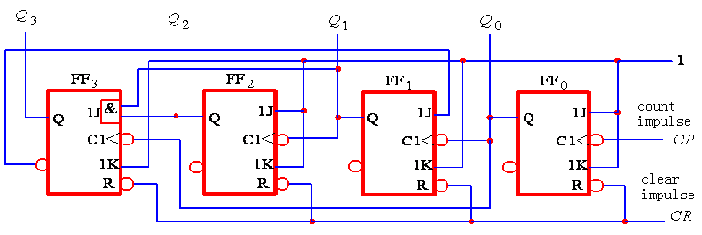
The drive equation of every flip-flop
b. Substitute every drive equation into the JK’S characteristic equation,get the next equation of every flip=flop.

Slide 40
（CP 1→0 effective）
（Q₀ 1→0 effective）
（Q₁ 1→0 effective）
（Q₀ 1→0 effective）
（CP 1→0）
（Q₀ 1→0）
（Q₁ 1→0）
（Q₀ 1→0）
C. state conversion table

Slide 41
Suppose the beginning is Q3Q2Q1Q0=0000，and substitute it into the next state equation and get the state conversion table
Present state | Next state | Clock impulse
Q₃ ^{n} Q₂ ^{n} Q₁ ^{n} Q₀ | Q₃ ^{n+1} Q₂ ^{n+1} Q₁ ^{n+1} Q₀ ^{n+1} | CP₃ CP₂ CP₁ CP₀
0 0 0 0 0 0 0 1 0 0 1 0 0 0 1 1 0 1 0 0 0 1 0 1 0 1 1 0 0 1 1 1 1 0 0 0 1 0 0 1 | 0 0 0 1 0 0 1 0 0 0 1 1 0 1 0 0 0 1 0 1 0 1 1 0 0 1 1 1 1 0 0 0 0 0 1 0 0 0 0 | 0 0 0 0 0 0 0 0 0 0 0 0 0 0 1 0 0 0

Slide 42
5.4 the design method of sequential circuit
Ⅰ. the design method of synchronous sequential circuit
1. design steps
(1)According to the request, suppose the state and derive its state map or state table
(2)state simplify, eliminate the redunt item and get the simplified state table(map)
(3)state divided or state coded. Divide a adaptable group binary code into the every state of the simplified state table(map)
(4)select the flip-flop’s kind
(5)derive the drive equation and output equation of the design circuit, according the state code table and the logical function of the adopted flip-flop
(6)picture the logical map according to the output and the drive equation
(7)check the self-starting

Slide 43
2. the example of designing the synchronous counter
Example: design a synchronous 5 carry system adding counter
(1)Draw the state conversion map and suppose the state, according to the designed request
(2)divide the state, the state conversion code table

Slide 44
State conversion order | Present state | Next state | Output
 | Q₂ ^{n} Q₁ ^{n} Q₀ ^{n} | Q₁ ^{n+1} Q₁ ^{n+1} Q₀ ^{n+1} | Y
S₀ S₁ S₂ S₃ S₄ | 0 0 0 0 0 1 0 1 0 0 1 1 1 0 0 | 0 0 1 0 1 0 0 1 1 1 0 0 0 0 0 | 0 0 0 0 1
（3）select flip-flop; JK
（4）ask the drive equation and the carry output equation; write out the drive table of the JK flip-flop and the next state equation of the circuit

Slide 45
the drive table of the JK flip-flop
Q^{n}→ Q^{n+1}
J K
0 0
0 1
1 0
1 1
0 ×
1 ×
× 1
× 0
Get the drive Karnaugh map according to the next state Karnaugh map and the drive table of the JK flip-flops:
The drive table of the JK flip-flops
Q^{n}→Q^{n+1}
J K
0 0
0 1
1 0
1 1
0 ×
1 ×
× 1
× 0
0
0
1
0
×
×
×
×

Slide 46
×
×
×
×
1
×
×
×
The drive table of the JK flip-flops
Q^{n}→ Q^{n+1}
J K
0 0
0 1
1 0
1 1
0 ×
1 ×
× 1
× 0

Slide 47
0
1
×
×
×
×
1
0
0
×
×
×
×
×
×
×
1
×
×
1
×
1
1
×
0
×
×
×
×
×
×
×

Slide 48
Picture the output Karnaugh, get the output of the circuit
(5)the drive equations

Slide 49
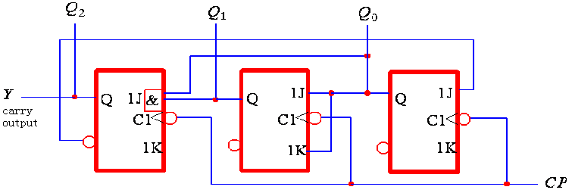
(6)Draw the logic map
(7)check the self-starting
Draw the whole state map of the circuit with the logic analysis method

Slide 50
According to the above picture, if the circuit come into the invalid states 101、110、111, it can come into the effective states 010、010、000 respectively under the CP influence. Therefore it can self-start.
3. The designment of the common sequential circuit
Example: design a serial data detector, it has one input end X, its function is checking the input data. When there are three input (or more) , its output Y is 1, otherwise it is 0.
Solution:
(1) According to the designing requirement, design the states
S0——beginning state or the state of no accepting 1;
S1——the state of accepting one 1
S2——the state of accepting two 1continuously;
S3——the state of accepting three(or more) 1continuously

Slide 51
(2)Draw the beginning state map
(3)Simplify the state map; from the map, it can be seen that S2 equal to S3. So combine them as one variable S2 ,get the simplified state map

Slide 52
(4)State divided
Suppose 3 states, express them with the three codes of the binary code combination (00、01、10、11）They are S0=00、S1=01、S2=11 in this example。

Slide 53
(5)select flip-flop. Select two D flip-flops in this example
(6)solution the state equation, drive equation and output equation
Write out the drive table of the D flip-flops and the next equation and the output equation
T he drive table of the D flip-flop
Q^{n}→ Q^{n+1}
D
0 0
0 1
1 0
1 1
0
1
0
1
From the output Karnaugh map, get the output equation of the circuit
From the next state Karnaugh and the drive table of the D flip-flop, get the drive Karnaugh map of the flip-flop

Slide 54
the drive table of the D flip-flop
Q^{n}→ Q^{n+1}
D
0 0
0 1
1 0
1 1
0
1
0
1
0
0
0
×
0
1
1
×

Slide 55
0
0
0
×
1
1
1
×
From the drive Karnaugh map, get the drive equation of the circuit
(7)Draw the logical map from the output equation and drive equation

Slide 56
(8)Check the self-starting

